Slide 2
Presentation Outline
Objectives
Deliverables
Final Design
Designs | Exploded View.
Production Plan
Currents Tasks | Next Tasks
Accomplished Tasks
Notes:
10/13/2020
2

Slide 3
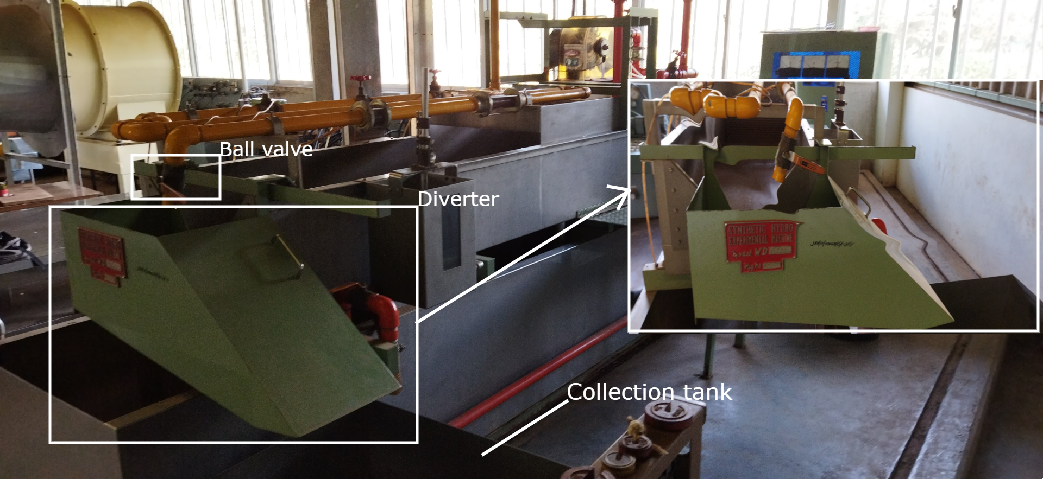
Synthetic Hydro-Experimental Machine
Notes:
Our project is based on the synthetic hydro-experimental machine currently present in JKUAT Fluid lab shown in the slide.

Slide 4
Introduction: Objectives
Main Objective
To automate the discharge collection process of the Synthetic Hydro-Experimental Machine.
Specific Objectives
To design an automated discharge flow control unit that can turn the ball valve in steps of less than 1⁰ and divert the flow in less than 1 second.
2. To design and fabricate a discharge handling unit with automated weight, time, and temperature measurements, and a discharge collection tank that can discharge in the shortest time possible.
3. To design a graphical user interface and a robust control algorithm to integrate the units

Slide 5
Deliverables
A discharge flow control mechanism that can turn in steps of less than 1 degree.
A diversion mechanism that can divert in less than a second
A discharge collection tank can collect more than 0.02m³ of the discharge.
A weight measurement device with a gauge factor of more than 2
A graphical user interface for controlling the system and displaying the results

Slide 6
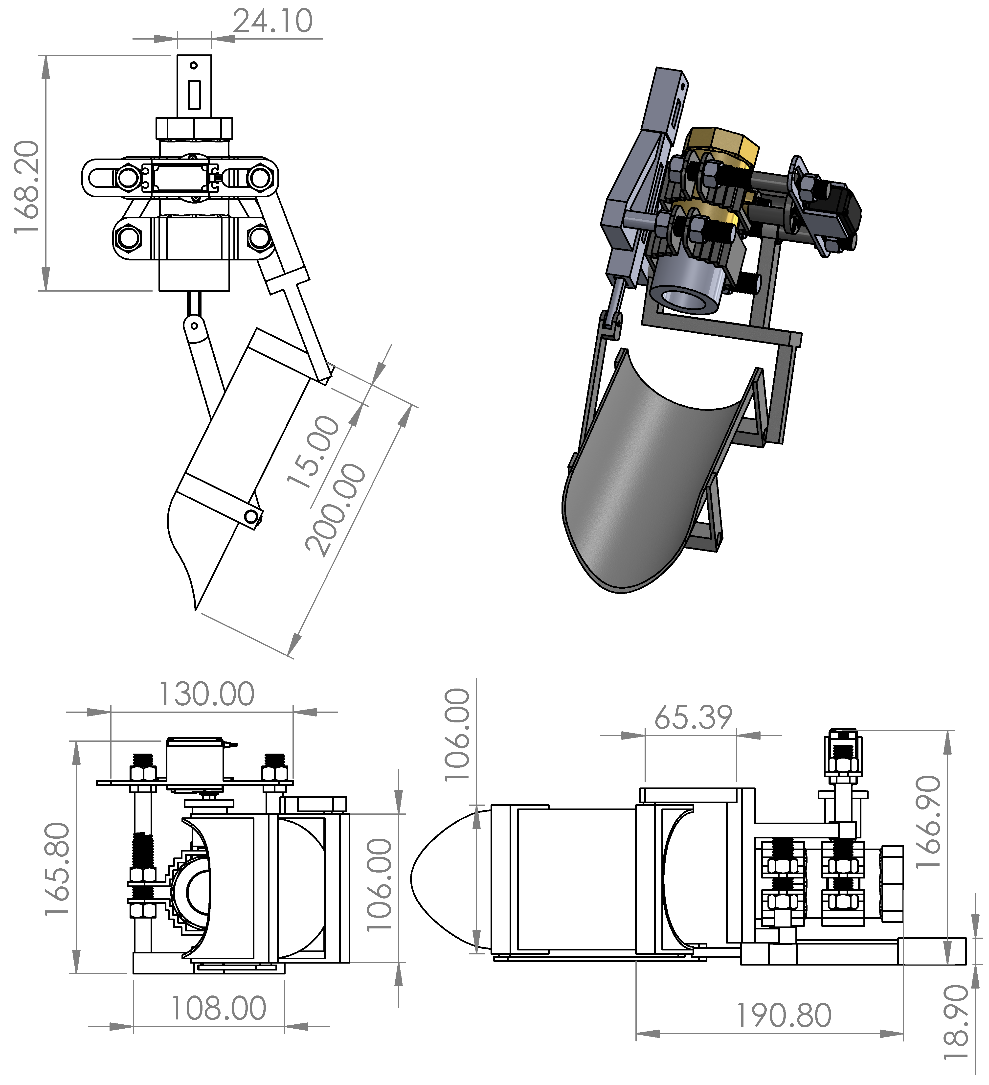
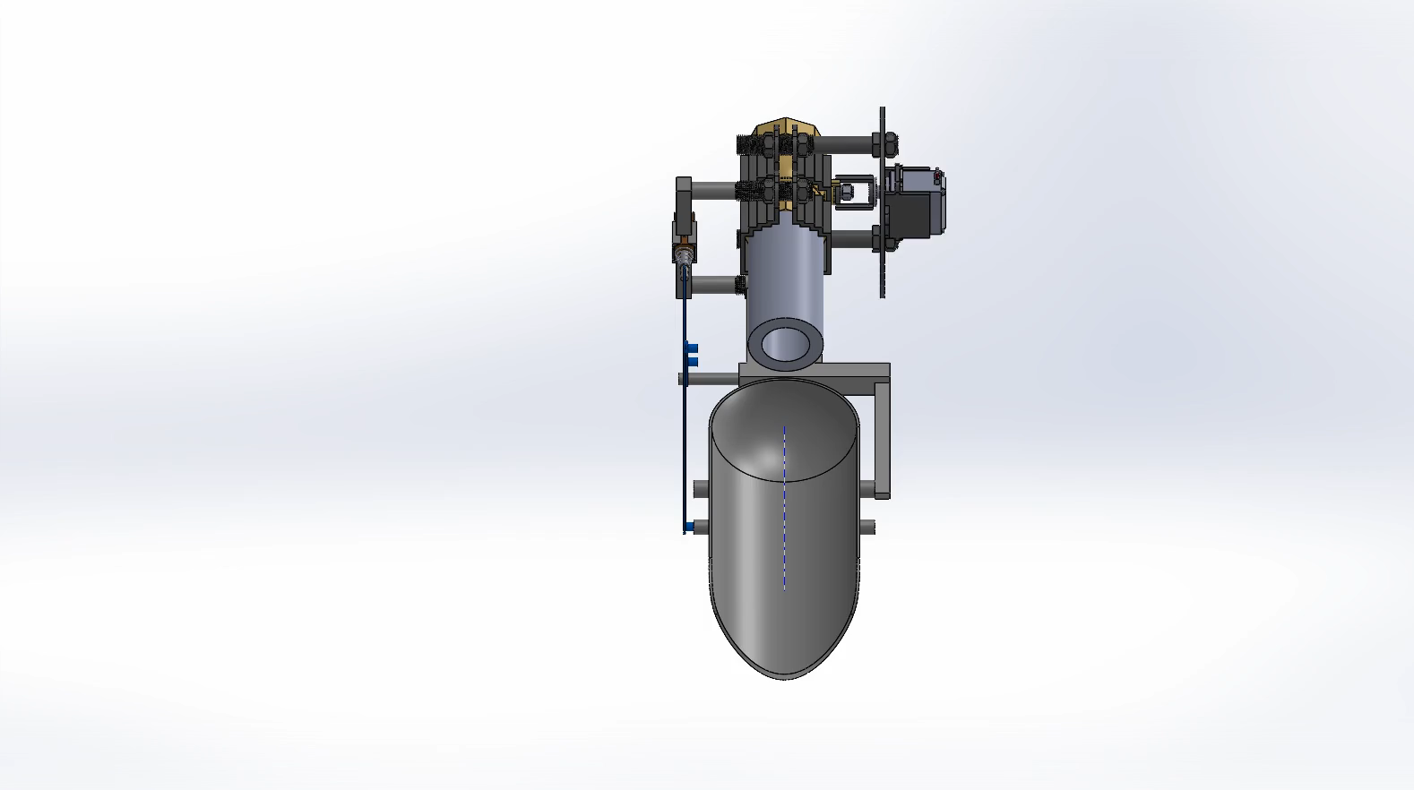
Final Design

Slide 7
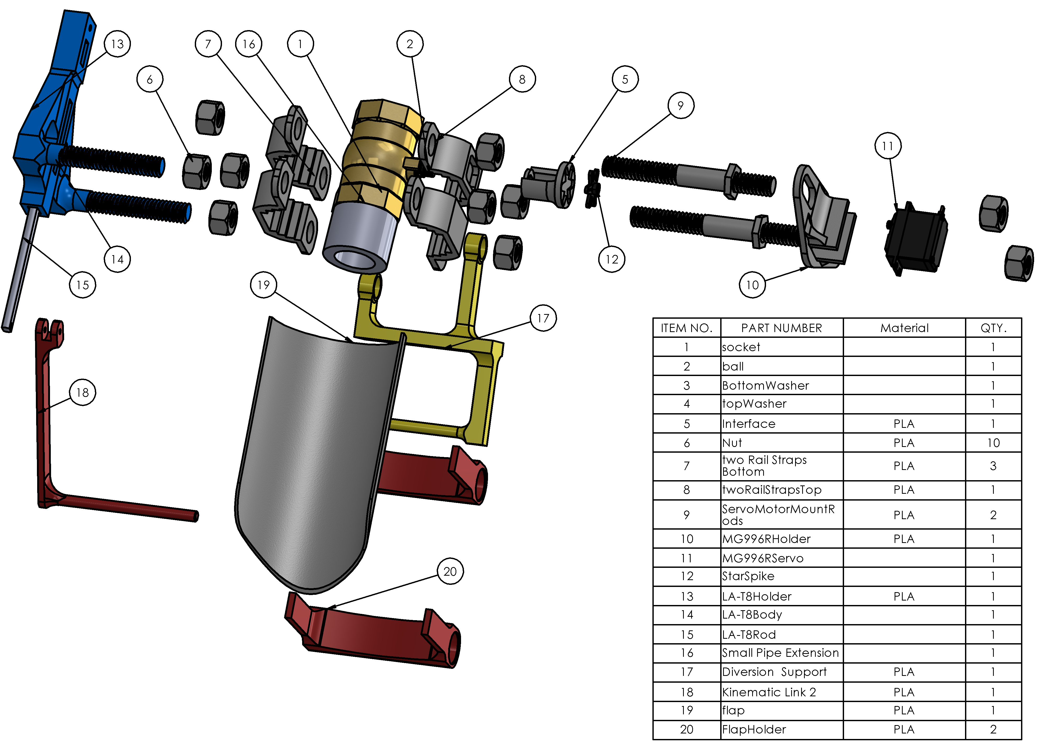
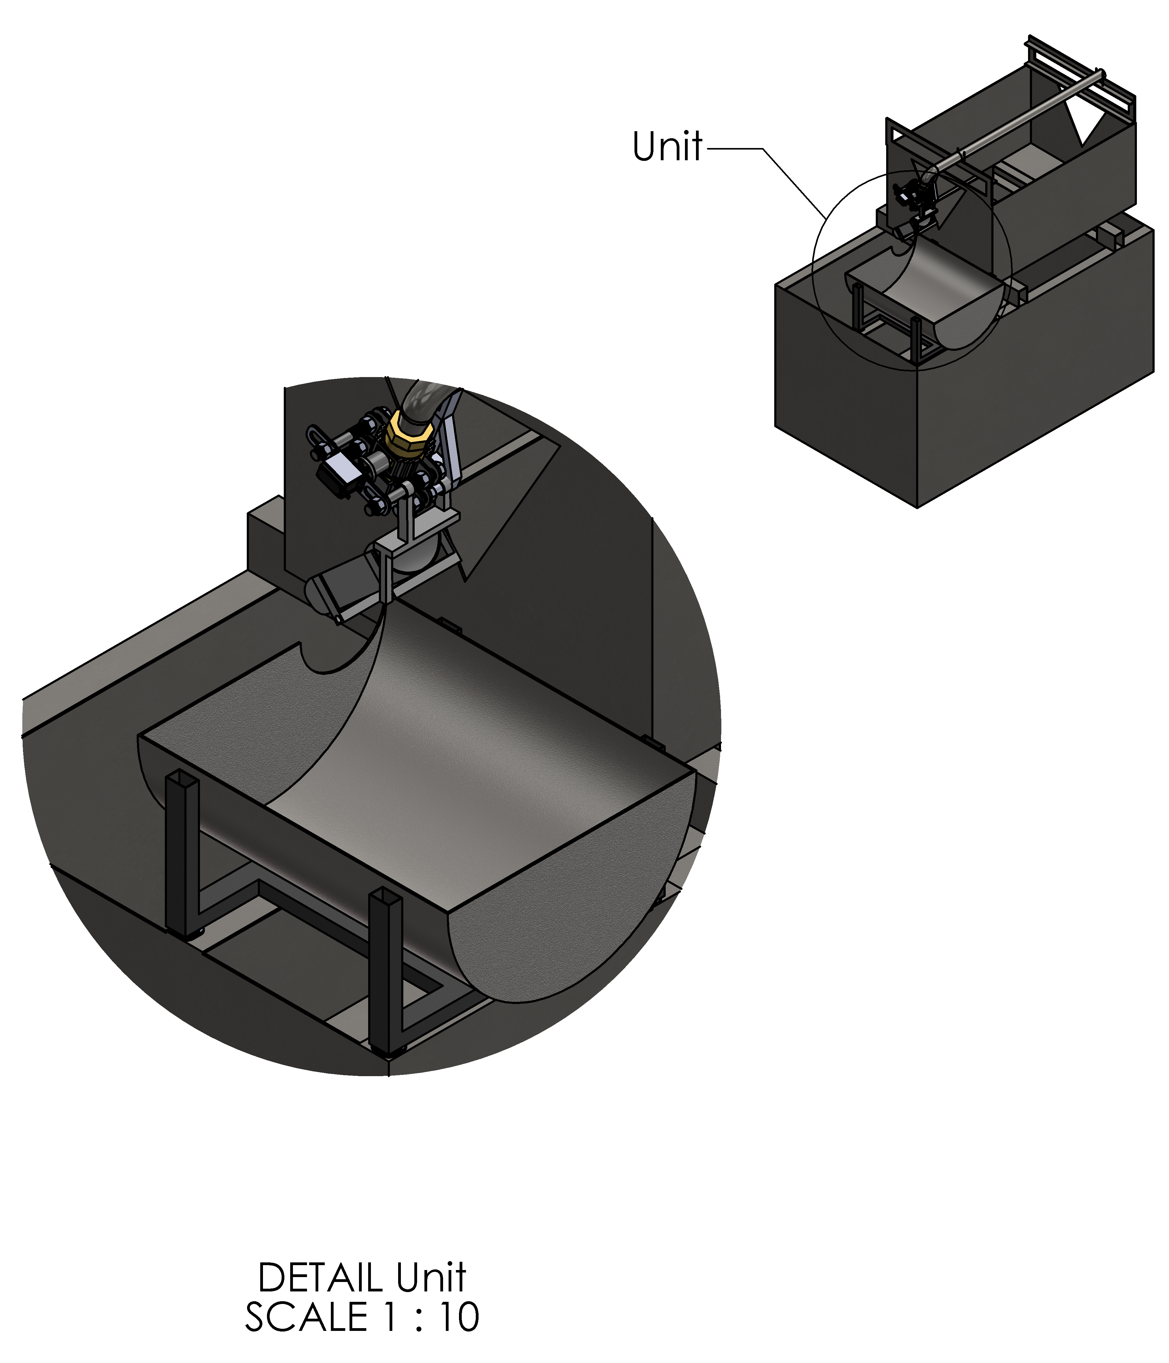
Final Design

Slide 8
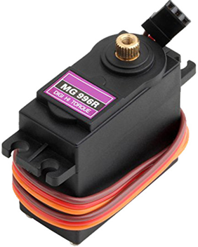
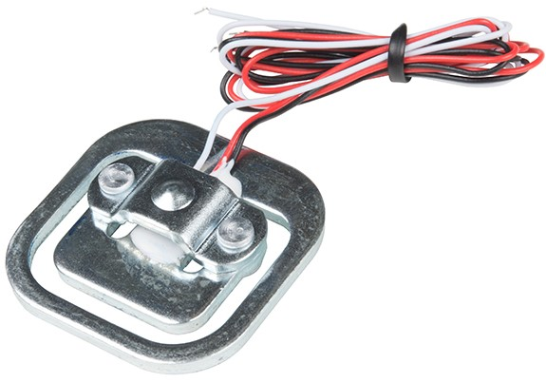
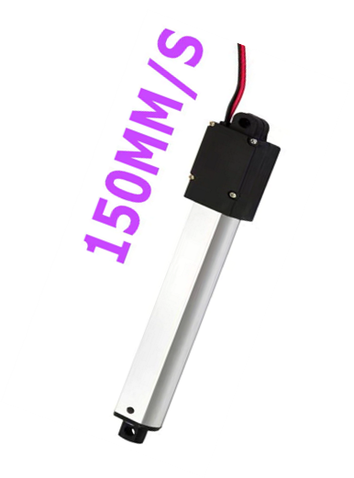
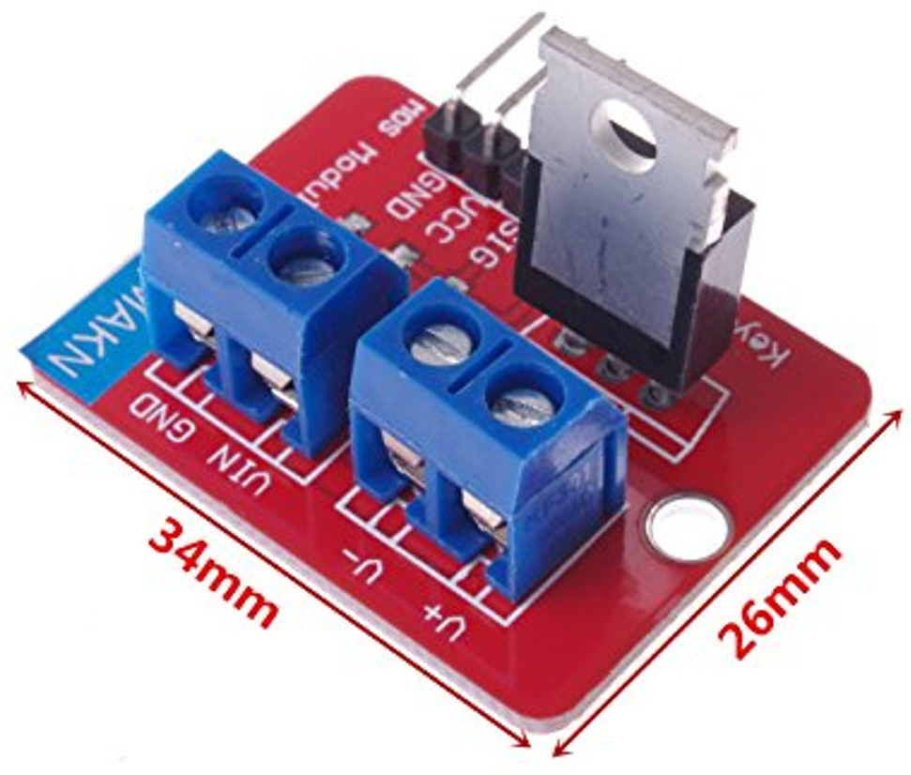
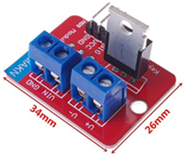
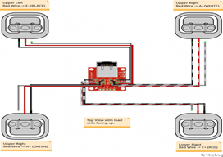
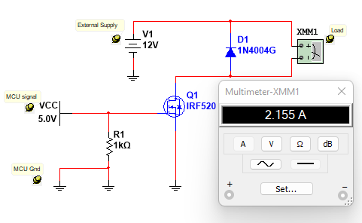
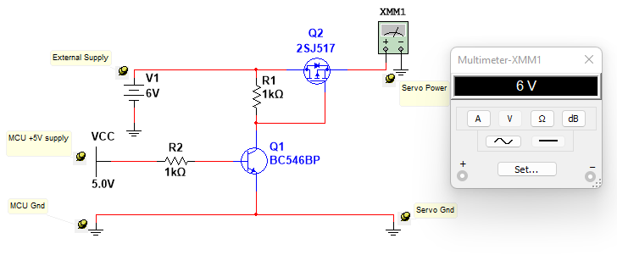
Final Design: Electrical
LA-T8 Micro-linear actuator
MG996R Servo motor
50Kg Strain-type load cells

Slide 9
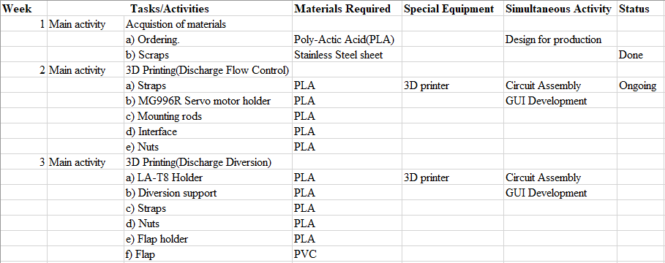
Production Plan

Slide 10
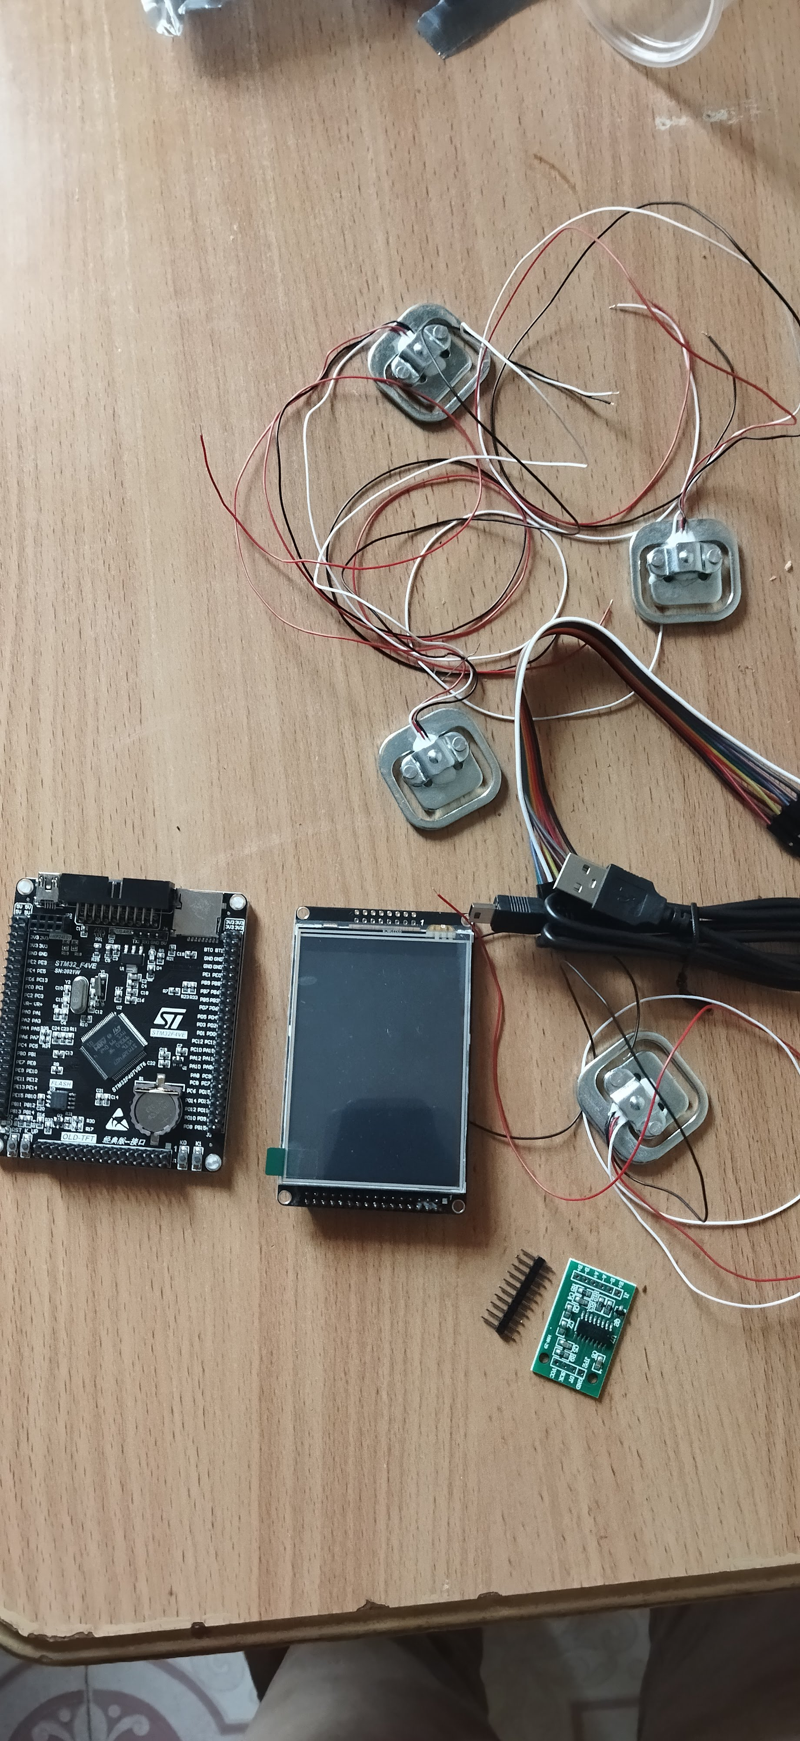
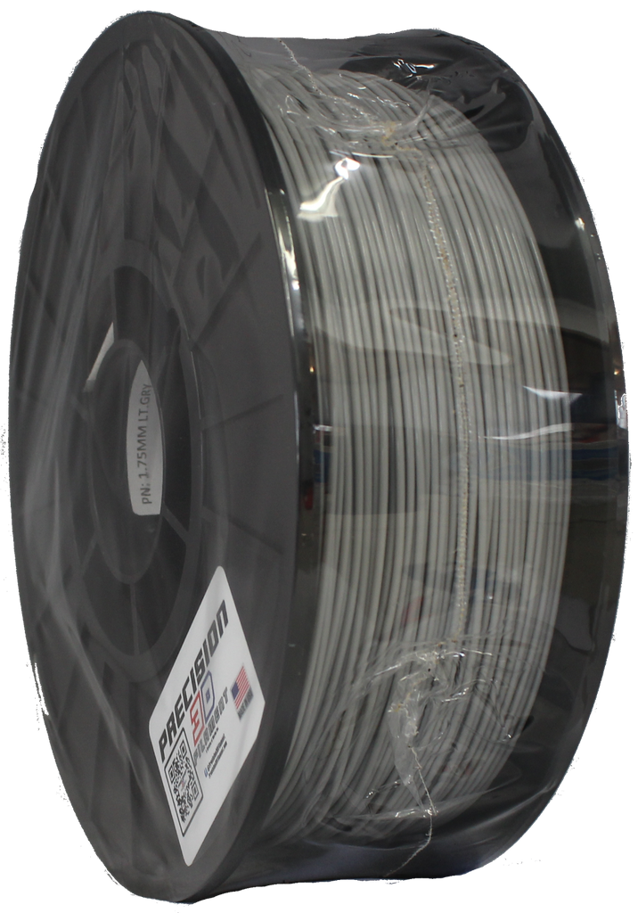
Tasks Accomplished
STM32F407VET6
LCD Touch 320*240(ILI9341)
Load Cells (50Kg)
PLA (2.85mm)

Slide 11
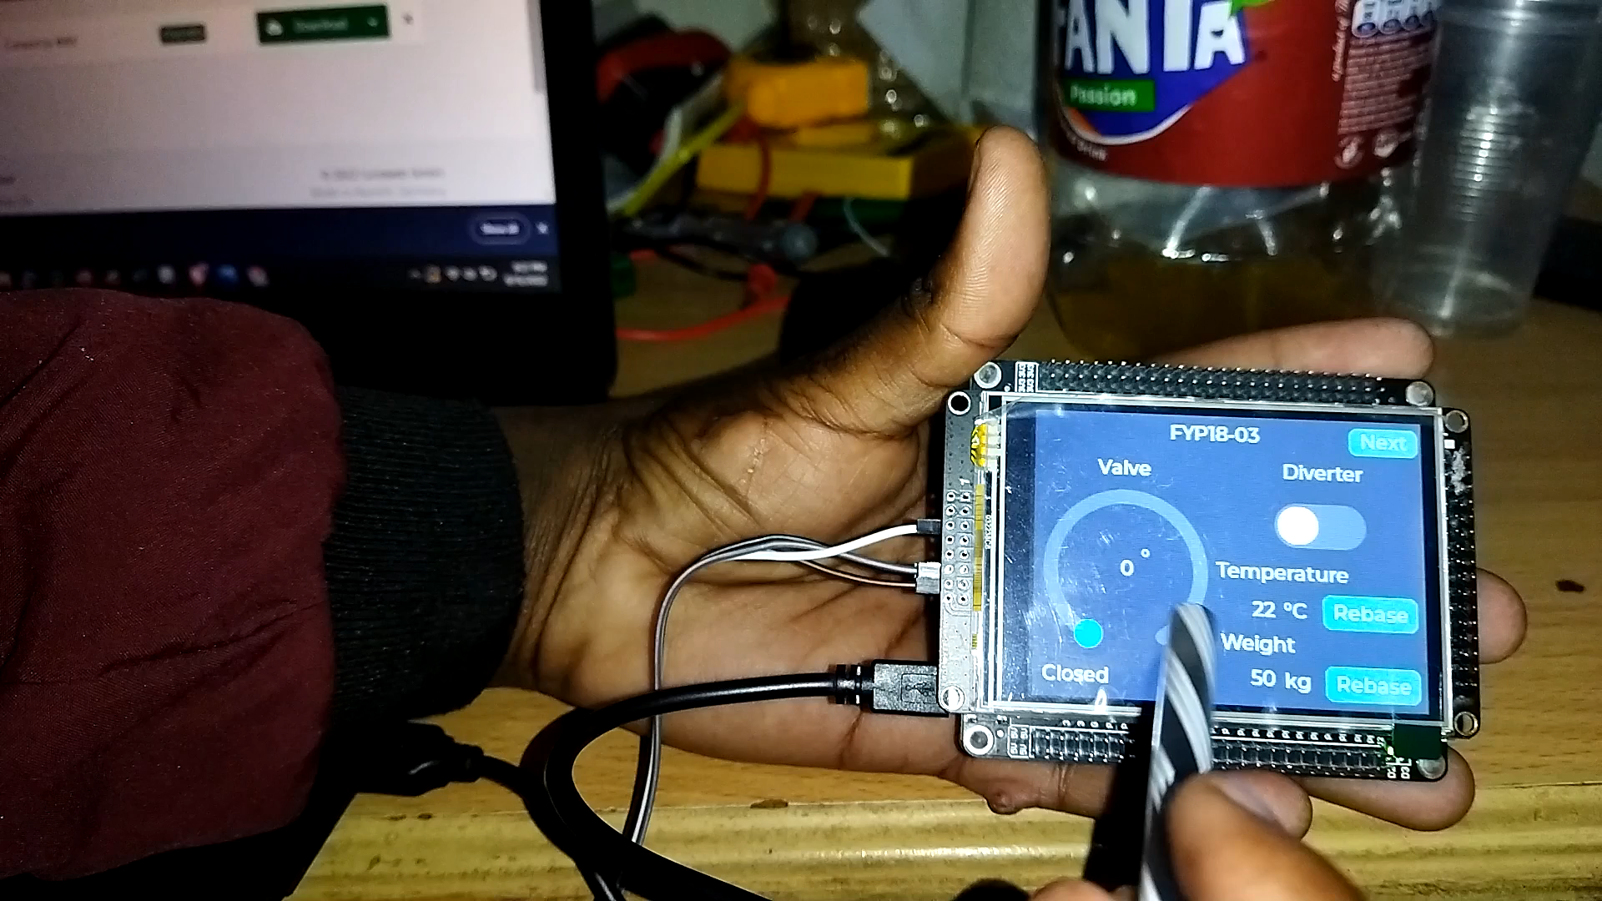
Tasks Accomplished

Slide 12


